Slide 1
Data Structures and Algorithms in Python

Slide 2
Data Structures

Slide 3
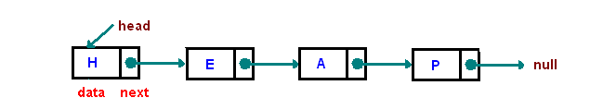
Singly Linked List

Slide 4
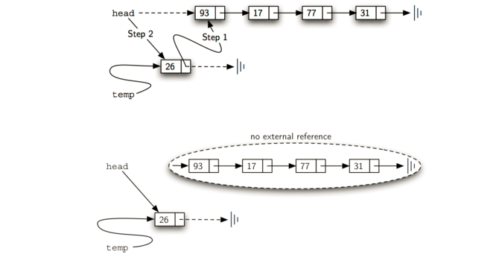

Slide 5
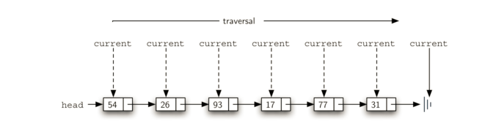

Slide 6
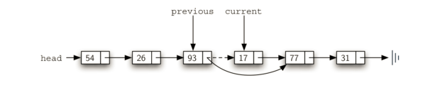

Slide 7
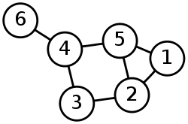
Undirected Graph

Slide 8
Union Find

Slide 9
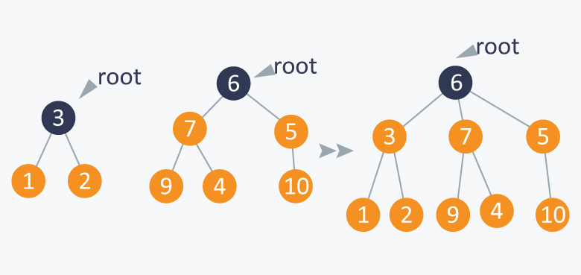

Slide 10
Algorithms

Slide 11
Breadth First Search

Slide 12
Sieve of Eratosthenes

Slide 13
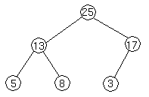
Heap Sort

Slide 14
Heapify
Input data: 4, 10, 3, 5, 1
4(0)
10(1) 3(2)
5(3) 1(4)
Applying heapify procedure to index 1:
4(0)
10(1) 3(2)
5(3) 1(4)
Applying heapify procedure to index 0:
10(0)
5(1) 3(2)
4(3) 1(4)

Slide 15
Thank you.

